Slide 1
SQL Server Replication
Hilary Cotter
hilary.cotter@gmail.com
relevantNoise.com

Slide 2
Agenda
What is replication
What options do you have for data distribution
What options do you have for fault tolerance
Replication Types
Snapshot Replication
Transactional Replication
Replicating DDL
Latency Tokens
Oracle Publishing
Bi-Directional Replication
Peer-to-Peer Replication
Merge Replication
Logical records
WebSync
Conflicts
Identity Range Management
Dynamic Filters
Join Filters
ActiveX Controls
Windows Synchronization Manager
Replication Monitor & RMO

Slide 3
What is replication?
Data Distribution
Data Aggregation – Central Subscriber
Scale Out Read Performance
Application Requirements
Synchronicity/Asynchronicity
Sometimes used for DR/HA
  Picture with SQL 2005 is better
  Failover is problematic
  Failback is more complicated
    Bi-directional Transactional

Slide 4
What options do you have for data distribution?
DTS/SSIS
  No tracking
Linked Servers
BCP
ADO/Ole-DB
Triggers

Slide 5
What options do you have for fault tolerance
Clustering
Database Mirroring
Host based replication
  Doubletake/DFS/Replistor
Hardware based replication
  EMC/HDS/Veritas
Backup/Restore
Log Shipping

Slide 6
Replication types
Snapshot
  Immediate Updating
  Queued Updating
Transactional
  Immediate Updating
  Queued Updating
  Bi-Directional
  Peer-to-Peer
Merge
  HIS
  Access – dropped in SQL 2005
  SQL CE/Mobile

Slide 7
Snapshot Replication
Generates point in time Snapshots of your data
  All replication types use this engine to generate snapshot
Good when a large portion of your data changes at one time but infrequently
  IE - Catalogs
DTS/SSIS better choice for 1 subscriber and well connected
New in SQL 2005 – concurrent snapshots by default
  Brief locking

Slide 8
Transactional Replication
Replicates transactions within the confines of a transaction
Breaks down transactions into singletons, applies these singletons within a transaction on the subscriber
Log Reader
  reads transactions marked for replication in transaction log
  Writes them as singletons in the Distribution Database
  Writes a record to the log saying transactions are replicated
  VLF can be marked as 0

Slide 9
Transactional Replication
Transactions written in msrepl_transactions
Commands written in msrepl_commands
  One to many relationship between msrepl_transactions and msrepl_commands
  Multiple rows per single command if we have a wide row or text
Distribution agent reads last transaction applied in the Subscriber
  select transaction_timestamp from MSreplication_subscriptions
  select xact_id from msrepl_transactions
  Backfills if transactions have not been flushed

Slide 10
Transactional Replication - performance
MSdistribution_status - view
Replicate the execution of stored procedures
Lightweight indexes on subscriber
Avoid subscriber triggers
  Replicate to article to a different table – audit table
Text – avoid, cast to varchar
Independent Agent

Slide 11
Transactional Replication - WTH?
Snapshot always available
  Create a snapshot immediately and keep the snapshot available to initialize subscriptions
  Anonymous/Named Subscriptions deprecated
  Create on demand
  Avoids the infamous
    You must rerun snapshot because current snapshot files are obsolete.
Security model
  Windows Account
  SQL Server Agent (default in SQL 2000)
  Connection to Publisher

Slide 12
Transactional Replication Subscribers
WTH?
Re-startable Snapshots
  Snapshot distribution picks up where it left off
    Article and Row
Independent Agent
  Spins up/down multiple agents on demand
  –SubscriptionStreams
  @SubscriptionStreams
  MaxCmdsInTran
  AutoSense Connection

Slide 13
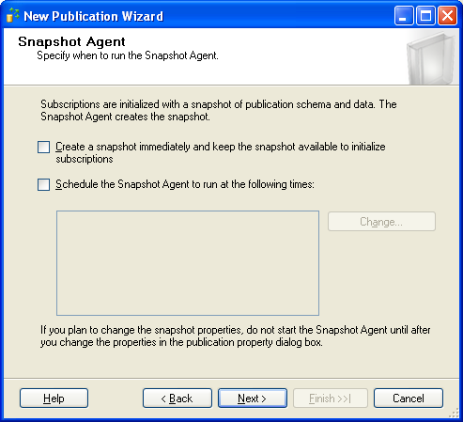
Snapshots

Slide 14
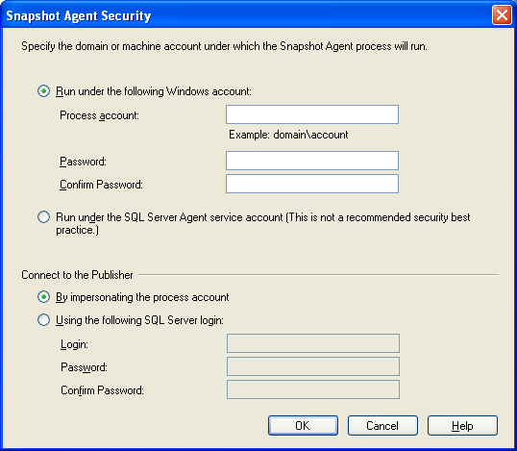
Security

Slide 15
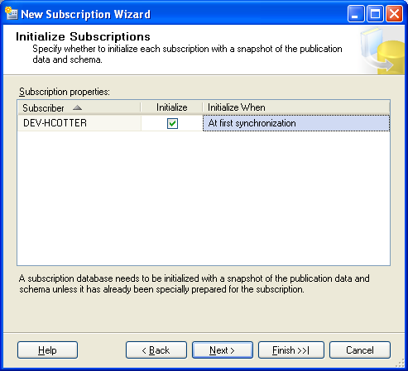
Subscriber Snapshot Options

Slide 16
Transactional Replication Subscribers
WTH?
Initialize
  Initialize From Backup
    http://msdn2.microsoft.com/en-US/library/ms147834(SQL.90).aspx
      Fixes Constraints, Identity, Triggers, etc for NFR
Immediately
  Generates a new Snapshot
First Synchronization
  Use an existing
Concurrent Snapshots

Slide 17
Transactional Replication Subscribers
WTH?
In SQL 2000 an update to a primary key column would be decomposed into a delete followed by an insert.
Stored in the Log as an Delete/Insert pair
Deferred Update
Consider - cascading deletes on subscriber tables
SQL 2005, updates to primary key columns are replicated as update statements, resulting in improved performance

Slide 18
Transactional Replication
Replicate DDL
Uses DDL Triggers
SQL 2000
  Sp_repladdcolumn
  Sp_repldropcolumn
SQL 2005
  Default =true in GUI, and sp_addpublication@replicate_ddl = 1

Slide 19
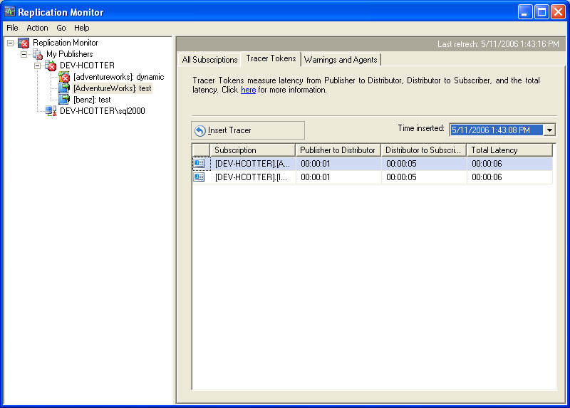
Transactional Replication – Latency Tokens

Slide 20
Oracle Publishing
Why Oracle – flipped a coin?
create publications in Oracle which will publish to SQL Server.
  SQL Server Subscriber
  Gateway
Triggers on Oracle Subscriber
Only Uni-Directional from Oracle to SQL Server
  No loopback
Enterprise Edition Only

Slide 21
Oracle Publishing
Connect to your SQL Server which will act as your distributor
right click on the Replication folder
select Distributor Properties
click the Publishers tab
Add, and select Add Oracle Publisher
Connect to the Oracle Publisher.
After you have created your Oracle Publisher, right click on your Local Publishers folder, and select New Oracle Publication. The Wizard is very similar to the New SQL Server publication Wizard.

Slide 22
Bi-Directional Transactional
Available by procs
Sp_addsubscription loopback_detection=true
Scalable to 2-3 subscribers
Carefully plan Identity seeds and increments to prevent PK Collisions
Or use a composite PK
Unlike Updateable Subscriptions supports majority of DML originating on the Subscriber

Slide 23
Peer-to-Peer Transactional
Enterprise Edition Only
Scalable up to 10-15
Partition to minimize conflicts
Multi-master replication
Ideal for identical data sets
Intended for scale out performance

Slide 24
Enabling Peer-to-Peer
Create a normal transactional publication
right click on your publication
Select Subscription Options
set Allow Peer to Peer subscriptions to true.
Deploy your subscription to all subscribers.
After the subscriptions have been deployed to all subscribers, right click on your publication and select Configure Peer to Peer Configuration Wizard.

Slide 25
Merge Replication
Dangers of Replication and a Solution
  Jim Gray
Designed for frequently offline clients
Design Goals
  Track changes
  Log and Resolve Conflicts
  Low resource and bandwidth foot print
  Survives interruptions

Slide 26
Merge Replication Internals
Updates and Inserts – 1 queue (MSMerge_Contents)
Deletes – another queue (MSMerge_Tombstones)
Triggers log DML to these tables
All DML which occurs between syncs belong to a generation
Generations are incremented per sync

Slide 27
Merge Replication
GUID tracking column
State moves at sync
Conflicts
Automatic Identity Range Management
Compensate for Errors
Column Level Tracking
Priorities
  Intended for Hierarchies
  Anarchy mode

Slide 28
Merge Replication – new features
Logical Records
  In SQL 2000 Merge sync commands were applied according to ArticleID in sysmergearticles
  Child records could be applied before parents
  Would enter a retry queue and be retried at the end of a batch
  Good practice to put NFR on all constraints
  In SQL 2005 all merge sync commands are order by DRI in a process called Logical Records
Download Only Articles
  Per article exchange type
  Conflict Resolver
  Permissions

Slide 29
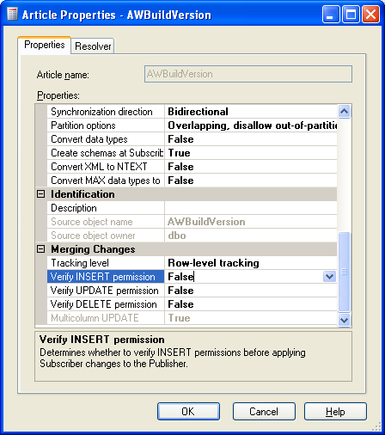
Merge Replication

Slide 30
Merge Replication
Pre-computed Partitions
Dynamic Join Filters
Demo

Slide 31
Web Sync
In SQL 2000 you were forced to use FTP or a VPN
VPNs = slow
FTP is considered to be an insecure solution
  Passwords plain text
  Anonymous
Connecting over the internet also means opening port 1433 for inbound connections on your firewall
SQL Server 2005 merge replication allows you to conf a web server to allow web synchronizations of clients over the internet through https.
Web server can be remote

Slide 32
Conflicts
PK Violations
Updating a deleted row
Column level tracking
Conflict Resolvers
Conflict Viewer allows you to view and resolve conflicts
SQL 2005 allows you to create your own .Net resolvers
Microsoft.SqlServer.Replication.BusinessLogicSupport

Slide 33
Identity Range Management
Checked with each sync and incremented
Two philosophies
Set it and forget it
  Leads to inefficient usage
  Can’t grow
Automatic Identity Range Management
  SQL Server increments it
  http://www.simple-talk.com/2005/07/05/replication/
  Must set range smaller than the max updates per sync
  Ranges are set by DBCC CheckIdent(Tablename, Reseed,value)
  And a check constraint

Slide 34
Automatic Identity Range Management
Initial ranges
NYC Detroit Englishtown
1-10,000 10,001-20,000 20,001-30,000
Before First Sync
8,000 10,100 20,002
After First Sync
30,001 10,100 20,002

Slide 35
ActiveX Controls
http://www.dbazine.com
Lightweight – in SQL 2005 as well
Can’t create publications with them
Only generate a snapshot and distribute it
And do a sync
Same model in WSM, and SQL CE/SQL Mobile

Slide 36
Windows Synchronization Manager
Programs/Accessories/Synchronize
Can pull/push Subscriptions on
  logon
  Idle
  Sense a connection
  Boot
Ideal for Merge/SQL Server Express (no SQL Server Agent)

